Slide 1

Interactive geometry with JSXGraph
Matthias Ehmann, Michael Gerhäuser, Carsten Miller, Bianca Valentin, Alfred Wassermann, Peter Wilfahrt
University of Bayreuth, Germany

Slide 2
Future trends in dynamic geometry

Slide 3
Future trends in dynamic geometry
Display files generated by a dynamic geometry system like GEONE_{X}T or GeoGebra

Slide 4
Future trends in dynamic geometry
Display files generated by a dynamic geometry system like GEONE_{X}T or GeoGebra
and
create geometric constructions or illustrate graphs

Slide 5
Future trends in dynamic geometry
Display files generated by a dynamic geometry system like GEONE_{X}T or GeoGebra
and
create geometric constructions or illustrate graphs
without using any plugins
like Java or Flash.

Slide 6
Why not Java or Flash?

Slide 7
Why not Java or Flash?
Require installation of external plugins.

Slide 8
Why not Java or Flash?
Require installation of external plugins.
Long initialization time, memory usage.

Slide 9
Why not Java or Flash?
Require installation of external plugins.
Long initialization time, memory usage.
Problems with non-Windows environments.

Slide 10
Why not Java or Flash?
Require installation of external plugins.
Long initialization time, memory usage.
Problems with non-Windows environments.
What to do on the iPhone, Blackberry, Palm Pre, Android, Google Chrome OS?

Slide 11
JSXGraph

Slide 12
JSXGraph
open source project at sourceforge.net

Slide 13
JSXGraph
open source project at sourceforge.net
developed at the University of Bayreuth

Slide 14
JSXGraph
open source project at sourceforge.net
developed at the University of Bayreuth
implemented completely in JavaScript

Slide 15
JSXGraph
open source project at sourceforge.net
developed at the University of Bayreuth
implemented completely in JavaScript
no plugin required

Slide 16
JSXGraph
open source project at sourceforge.net
developed at the University of Bayreuth
implemented completely in JavaScript
no plugin required
supports all major browsers (including Internet Explorer)

Slide 17
JSXGraph
open source project at sourceforge.net
developed at the University of Bayreuth
implemented completely in JavaScript
no plugin required
supports all major browsers (including Internet Explorer)
zero initialization time

Slide 18
Integrated features

Slide 19
Integrated features
Dynamic Geometry: Euclidean and homogeneous coordinates, lines, circles, polygons, gliders, animations, sliders, conic sections

Slide 20
Integrated features
Dynamic Geometry: Euclidean and homogeneous coordinates, lines, circles, polygons, gliders, animations, sliders, conic sections
Curves: Function graphs, polar plots, parametric curves, data plots, bezier curves

Slide 21
Integrated features
Dynamic Geometry: Euclidean and homogeneous coordinates, lines, circles, polygons, gliders, animations, sliders, conic sections
Curves: Function graphs, polar plots, parametric curves, data plots, bezier curves
Turtle graphics

Slide 22
Integrated features
Dynamic Geometry: Euclidean and homogeneous coordinates, lines, circles, polygons, gliders, animations, sliders, conic sections
Curves: Function graphs, polar plots, parametric curves, data plots, bezier curves
Turtle graphics
Charts

Slide 23
Integrated features
Dynamic Geometry: Euclidean and homogeneous coordinates, lines, circles, polygons, gliders, animations, sliders, conic sections
Curves: Function graphs, polar plots, parametric curves, data plots, bezier curves
Turtle graphics
Charts
Display files: GEONE_{x}T, Geogebra, Cinderella (partially), Intergeo, ArcView

Slide 24
First example

Slide 25
First example
var brd = JXG.JSXGraph.initBoard('box',
{boundingbox:[-3, 12, 12, -2],
keepaspectratio:true, shownavigation:false,
showcopyright:false,axis:true});
var a = brd.create('point', [3,3], {name:'A'});
var b = brd.create('point', [6,2], {name:'B'});
var c = brd.create('point', [1,8],
{name:'C', strokeColor:'black', fillColor:'green',
highlightFillColor:'black', size:8});
var l = brd.create('line', [b, c], {name:'g'});
var d = brd.create('point', [8,7], {name:'D'});
var e = brd.create('point', [10.5,5], {name:'E'});
var cr = brd.create('circle', [d, e], {name:'k_1'});
var i1 = brd.create('intersection', [cr, l, 0],
{face:'square'});
var i2 = brd.create('intersection', [cr, l, 1],
{face:'[]', size:7});

Slide 26
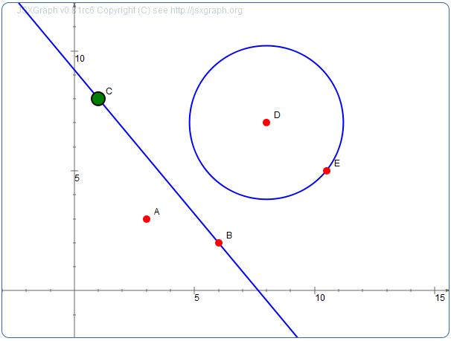
First example
var a = brd.create('point', [3,3], {name:'A'});
var b = brd.create('point', [6,2], {name:'B'});
var c = brd.create('point', [1,8],
{name:'C',strokeColor:'black',
fillColor:'green',size:8});
var l = brd.create('line',[b, c]);
var d = brd.create('point', [8,7], {name:'D'});
var e = brd.create('point', [10.5,5], {name:'E'});
var cr = brd.create('circle', [d, e], {name:'k_1'});
var i1 = brd.create('intersection',
[cr, l, 0], {face:'square'});
var i2 = brd.create('intersection',
[cr, l, 1], {face:'[]', size:7});
Live version

Slide 27
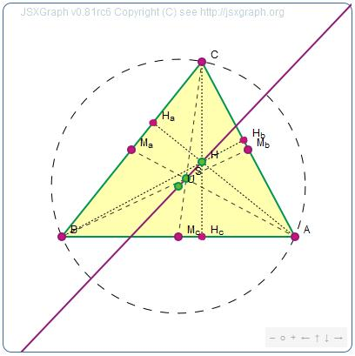
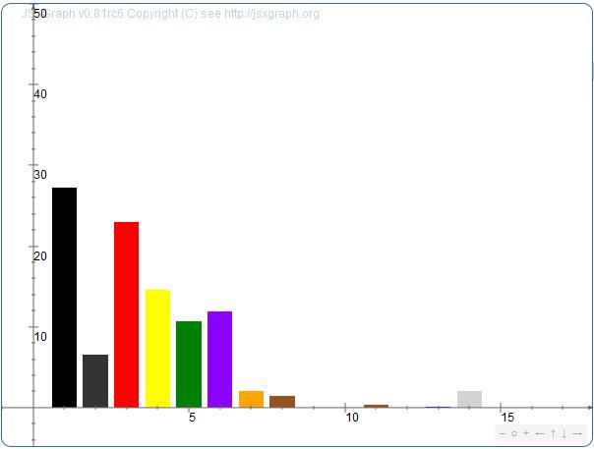
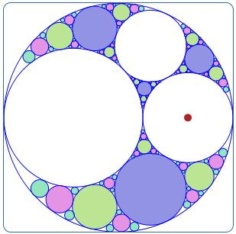
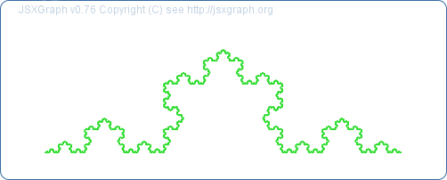
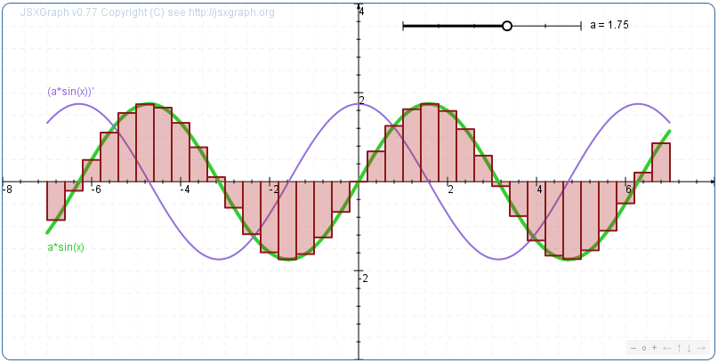
More examples
Geometry: Euler line
Interactive bar chart
Appolonian circle packing
Koch curve with turtle graphics
Calculus

Slide 28
Constructing with math syntax

Slide 29
Constructing with math syntax
Having to program with JavaScript to display math with JSXGraph is a hurdle for using.

Slide 30
Constructing with math syntax
Having to program with JavaScript to display math with JSXGraph is a hurdle for using.
Alternative solution is needed!

Slide 31
Constructing with math syntax
JSXGraph can parse a syntax similar to what is taught in schools

Slide 32
Constructing with math syntax
JSXGraph can parse a syntax similar to what is taught in schools, e.g.
P(1,1)

Slide 33
Constructing with math syntax
JSXGraph can parse a syntax similar to what is taught in schools, e.g.
P(1,1)
Q(-2,3)
g=[PQ]

Slide 34
Constructing with math syntax
JSXGraph can parse a syntax similar to what is taught in schools, e.g.
P(1,1)
Q(-2,3)
g=[PQ]
k(P,1.5)

Slide 35
Constructing with math syntax
JSXGraph can parse a syntax similar to what is taught in schools, e.g.
P(1,1)
Q(-2,3)
g=[PQ]
k(P,1.5)
||(g,R)

Slide 36
Constructing with math syntax
JSXGraph can parse a syntax similar to what is taught in schools, e.g.
P(1,1)
Q(-2,3)
g=[PQ]
k(P,1.5)
||(g,R)
EASY!

Slide 37
Examples
||(P,g)
g=]AB[
P(1,1)
1/2(A,B)
<(A,B,C)
Y[A,B,C,D]
Constructing with math syntax
Q(g,3,2)
f:x^2+2*x+5
|_(P,g)
X=g&k1
k(A,[PQ])

Slide 38
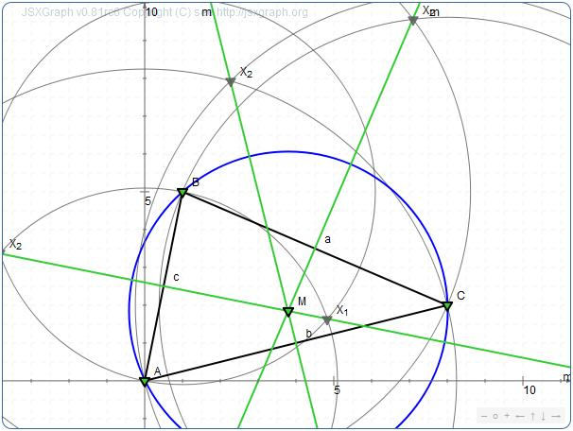
Macros
Perpendicular bisector (defined by two points D,E)
Bisector = Macro(D,E)
{
k1=k(D,E); k2=k(E,D); X=k1&k2; m=]X_1 X_2[;
}
Circumcircle
g1=bisector(A,B);
g2=bisector(B,C);
g3=bisector(A,C);
M=g1.m&g2.m;
k(M,A);

Slide 39
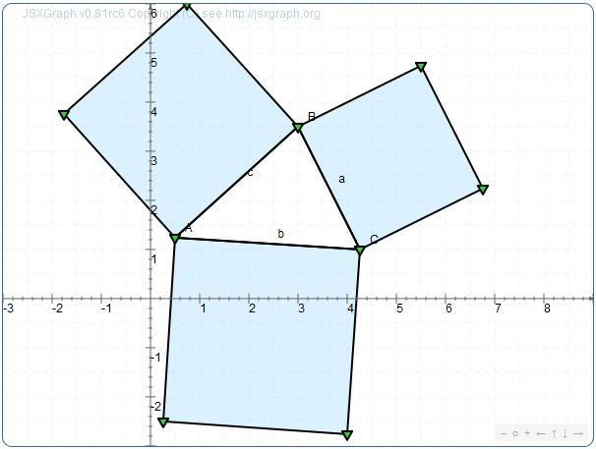
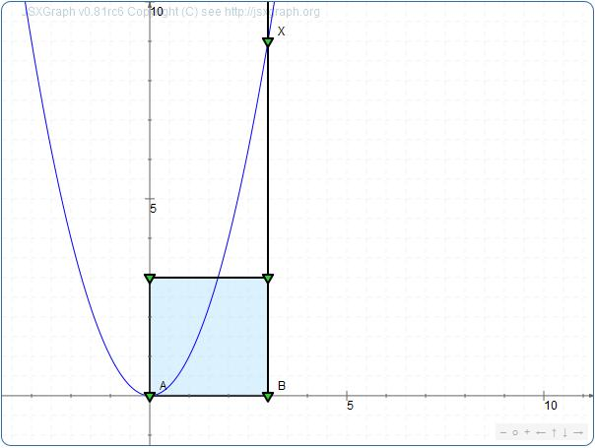
Macros
Square (defined by two points D,E)
Square = Macro(D,E)
{ k1=k(E,D) nolabel draft; x=[DE] nolabel draft;
v=|_(x,E) draft; X=k1&v nolabel; z=||(x,X_1) draft;
z2=|_(x,D) draft; Y=z2&z nolabel; P[X_1,Y,D,E] nolabel;
}
Pythagoras
Square function
q1=quadrat(A,B);q2=quadrat(B,C);
q3=quadrat(C,A);
q1=quadrat(A,B);

Slide 40

Any questions?

Slide 41
Thank you for your attention!
http://jsxgraph.org

